Slide 1

RUNGTA COLLEGE OF DENTAL SCIENCES AND RESEARCH
INTRA CANAL MEDICAMENTS
DEPARTMENT OF CONSERVATIVE DENTISTRY AND ENDODONTICS

Slide 2
Specific learning Objectives
Core areas* | Domain ** | Category #
Introduction | Cognitive | Must know
Definitions | Cognitive | Must know
Classifications | Cognitive | Must know
At the end of this presentation the learner is expected to know ;

Slide 3
Content
1. Introduction
2. History
3. Function
4. Ideal requirements of ICM
5. Various types ICM
6. Characteristics of ICM
7. Placement of ICM

Slide 4
INTRODUCTION
Intra canal medicaments include any agent with intended pharmacological action when introduced in the root canal
Intra canal dressings more concisely describe medicaments left in the root canal to exert their effects over a long period or most commonly as intra treatment dressings or inter appointment dressings
Intra canal dressing increases the power of sanitization process achieved by cleaning and shaping of root canal
Selection of intra canal medication depends upon:
Root canal micro biota
Mechanism of action of medication

Slide 5
History
Around 20th century – Formaldehyde containing materials eg: formocresol and iodoform pastes were introduced.
Anti biotic containing medicaments eg: Grossman’s polyantibiotic paste and ledermix
Calcium hydroxide advocated since 1930 has gained popularity in the last three decades in all aspects of endodontics.

Slide 6
Functions
Primary functions:
Asepsis, anti sepsis & disinfection:
Secondary functions
Induction of hard tissue formation
Pain control
Control of exudation & bleeding
Control of inflammatory root resorption

Slide 7
Ideal requisites of intra canal medicaments
Effective germicide & fungicide
Non irritating to periapical tissues
Stable in solution form
Prolonged antimicrobial action
Remain active in presence of blood & pus etc.
Low surface tension
Should not interfere with repair of periapical tissue
Not stain tooth
Should be capable of inactivation in culture media
Not induce all-medicated immune response

Slide 8
Various intra canal medicaments used
Essential oils-eugenol
Phenolic compounds
Phenol
Paramonochlor or para-chlorophenol
Camphorated para-chlorophenol
Cresatin
Aldehydes
Formocresol
Paraformaldehyde
Glutaraldehyde
Calcium Hydroxide
Halogens
Chlorine-sodium hypochlorite
Iodine
Chlorhexidine gluconate
Antibiotics
Corticosteroid-antibiotic combination
Quaternary Ammonium Compounds

Slide 9
Characteristics of various intra canal medicaments
Essential oils
Eugenol
Chemical essence of oil of clove
Primarily pain relieving effect limited antiseptic effect
Effects are divided into low-dose (beneficial effects) and high-dose (toxic effects)
Low dose | High dose
Inhibits prostaglandins synthesis | Induces cell death
Inhibits nerve activity | Inhibits cell respiration
Inhibits white cell chemotaxis
Uses:
Temporary dressing for pain control
Root canal sealer

Slide 10
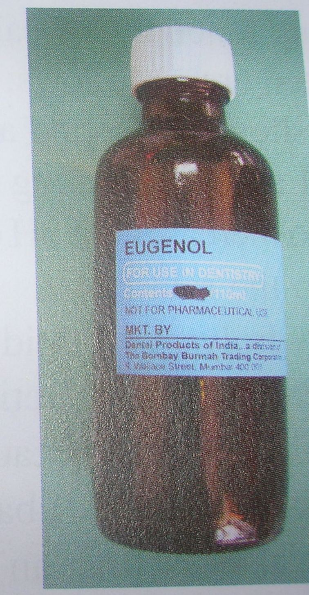

Slide 11
Characteristics of various intra canal medicaments
Phenolic Compounds
Phenol
Disinfectant and caustic action
Strong inflammatory potential, high toxicity to efficacy ratio
Composition:
Liquified Phenol (carbolic acid) consist of nine parts of phenol, one part of water
Uses:
Used for disinfection before periapical surgery
Used for cauterizing tissue tags that resist removal with broaches or files

Slide 12
Parachlorophenol
Aqueous solution destroys a variety of micro-organisms found in infected root canals
High toxicity to efficacy ratio, hence not very popular
Composition:
Substitution product of phenol in which chlorine replaces one of the hydrogen atoms (C₆H₄OHCL)
Use as one percent aqueous solution
Uses:
Used as dressing of choice for infected tooth

Slide 13
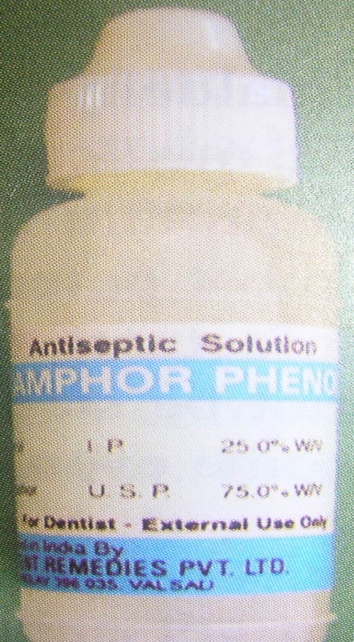
Camphorated Para-chlorophenol (CMCP)
High degree of popularity
Vapors pass through the apical foramen
Composition:
Two parts of para-chlorophenol plus three parts of gum camphor → camphorated para-chlorophenol
Camphor is added to para-chlorophenol because it
Has diluent action
Prolongs the antimicrobial action
Reduces irritating effect of PCP
Serves as a vehicle for solution
Uses:
Used as dressing of choice for infected teeth

Slide 14
Cresatin
Also known as metacresylacetate
Has antiseptic and obtundent properties
Less irritating to periapical tissues
Composition:
This substance is clear, stable, oily liquid of low volatile nature

Slide 15
Aldehydes
Formaldehyde, paraformaldehyde and glutaraldehyde commonly used intracanal medicaments in root canal therapy
Formocresol
Most commonly used as a dressing for pulpotomy to fix the retained pulpal tissue, although it is also used as a intra-treatment medicament when a pulpotomy is performed as emergency treatment to relieve pain
It is a strong disinfectant that combines with albumin to form an insoluble, indecomposable substance
Causes necrosis of the tissue followed by persistent inflammatory reaction
Said to produce cell mediated immune reponse
It is a non-specific bactericidal medicament most effective against aerobic and anaerobic organisms found in a root canal
Competition:
Formaldehyde ----- 19 %
Cresol ----- 35 %
Water and glycerine ----- 46 %
Toxic and mutagenic properties are of concern

Slide 16
Paraformaldehyde
Polymeric form of formaldehyde
Properties similar to formaldehyde that is toxic, allergenic and genotoxic in nature
Composition:
N2- a compound containing paraformaldehyde as its primary ingredient. Contains eugenol and phenylmercuric borate and sometimes corticosteroids, antibiotics and perfume. Antibacterial effect last for seven to ten days
Glutaraldehyde
Strong disinfectant and fixative
Does not produce an immune reaction
Composition:
Colorless oil slightly soluble in water and slight acidic action
Recommended in low concentration (2 percent) as an intracanal medicament
All phenolic compounds are highly volatile with low surface tension. Therefore they are placed on a cotton pellet in the chamber of the tooth during treatment, the vapors will permeate the entire canal preparation. Only a tiny quantity of medication is needed for effectiveness.

Slide 17
Calcium Hydroxide
Was introduced in endodontics by Hermann
Functions:
High PH
Antibacterial action Inactivates the activity of lipopolysaccharide.
It is best used as an intracanal medicament when there is excessive delay between appointments- efficacious as long as it remains in the root canal
Use of calcium hydroxide in “weeping” canal cases
Composition:
Commercial preparations of calcium hydroxide are packed in syringe or the powder maybe mixed with water or glycerine to form a thick paste

Slide 18
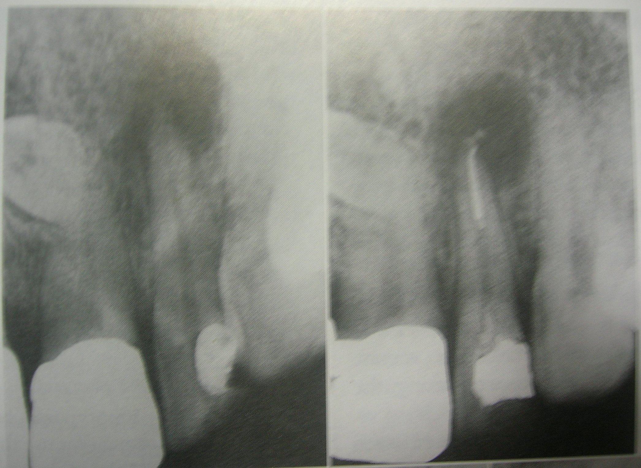
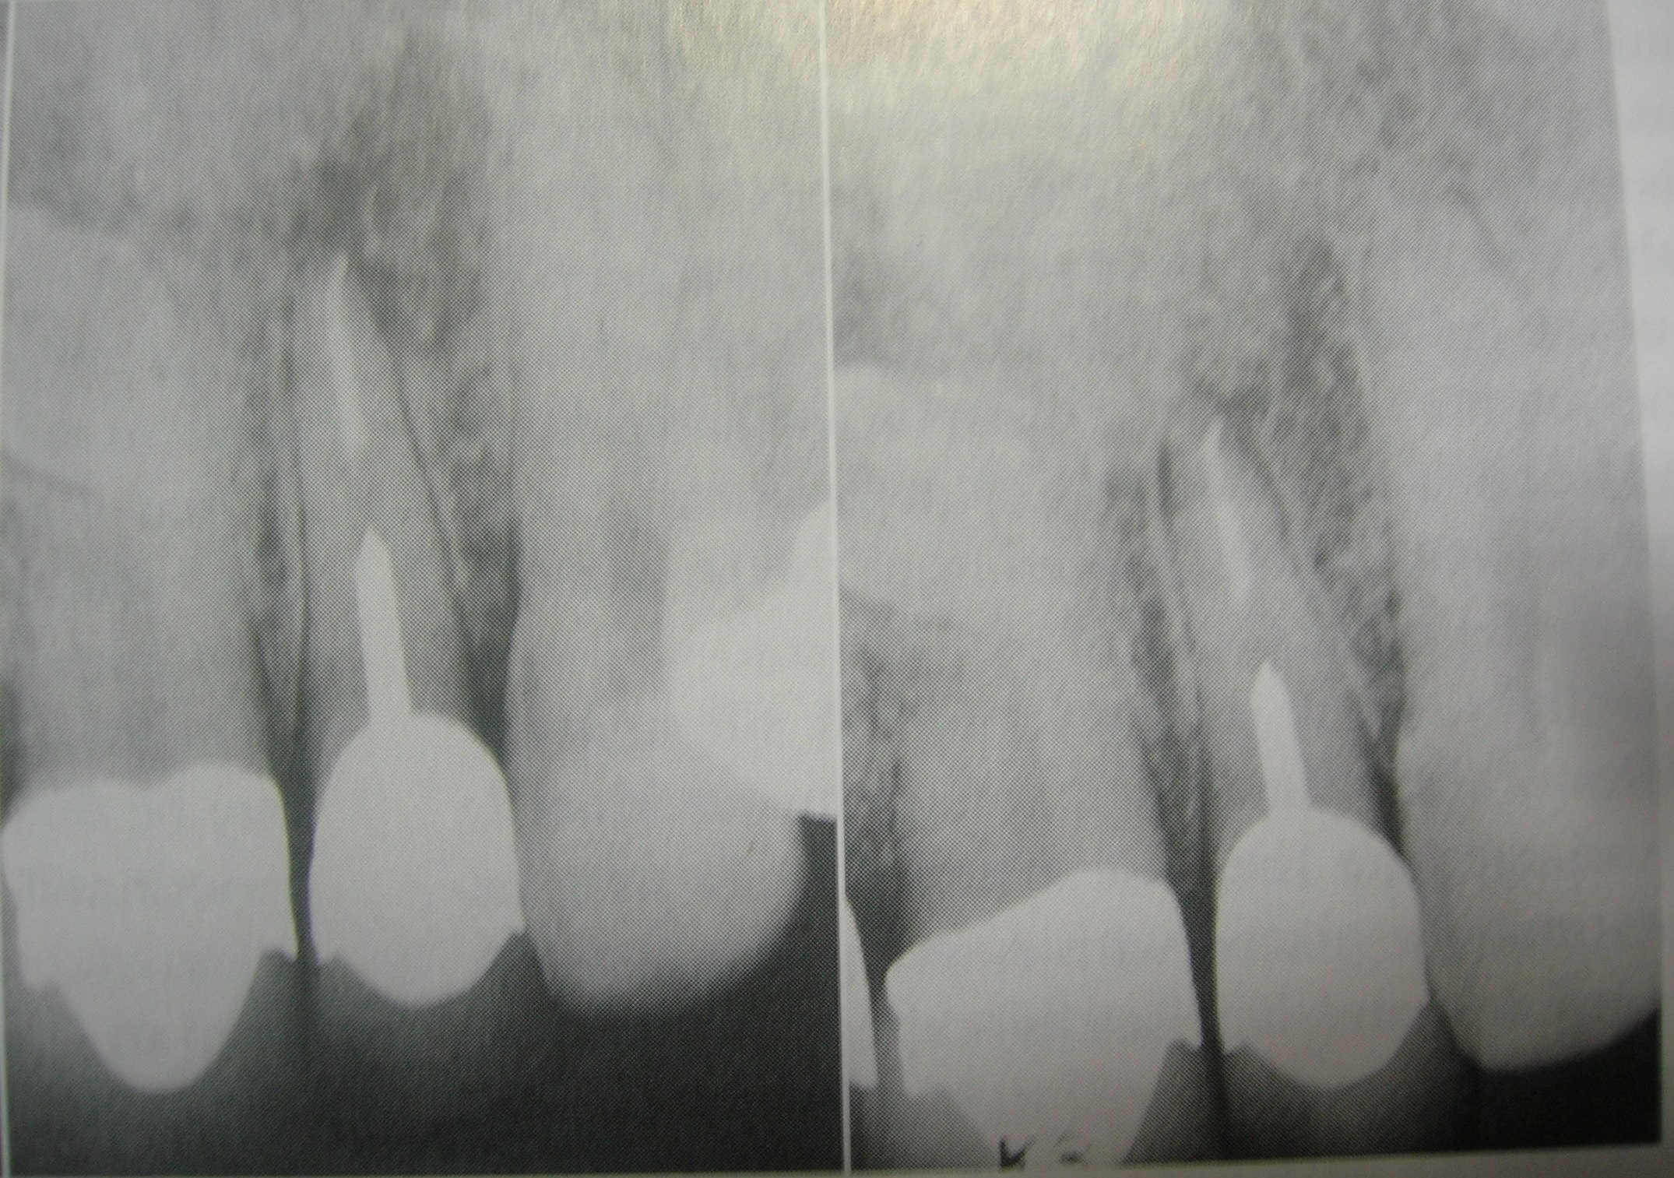

Slide 19
Halogens
Chlorine-Sodium Hypochlorite
Sometimes used as an intracanal medicament
Chlorine- lowest anatomic weight, greatest disinfectant action
Vapors are bactericidal
Activity is intense but short duration, hence should be applied to the root canal every other day
Iodides
Highly reactive, antiseptic action
Antibacterial effect, short duration
Composition:
Iodophors- 2% iodine in 5% potassium iodide solution
Current applications as short term dressing- 2% solution of iodine in 4% aqueous potassium iodide

Slide 20
Chlorhexidine gluconate
Substanivity,broad spectrum anti-bacterial activity,low toxicity
Composition:
Effective concentrations of 0.2-2% range
Dressing: 1-5% gel

Slide 21
Antibiotics
PBSC paste
Wide use among dentist
Available in paste form that is injected in the canal or impregnated on paperpoints.
Decreased popularity now due to reported allergic reactions to the drugs
Composition:
Penicillin- effective against gram-positive microorganisms
Bacitracin- effective against penicillin-resistant microorganisms
Streptomycin – effective against the gram-negative microorganisms
Caprylate (sodium salt)- effective against fungi
Or Nystatin- effective against fungi
Sulfonamides
Sulfanilamide and Sulfathiazole used as medicaments by mixing with sterile distilled water
Yellowish tooth colouration reported
Uses:
Usually recommended while giving closed dressing in a tooth which had been left open after an acute periapical abscess

Slide 22
Corticosteroid-antibiotic combination
Available as Tetra-Cortril, Corti-Sporin, Mycolog and other combinations
Effective in the treatment of extreme tenderness to percussion after over instrumentation
Placed into the inflamed periapical tissue by paperpoint or reamer
Corticosteroid- reduces inflammation and pain relief
Antibiotic- prevent overgrowth of microorganisms

Slide 23
Quaternary Ammonium Compounds
Compounds that lower surface tension of solutions
Surface active effect – results in antiseptic action
Composition:
9-aminoacridine belongs to the group of mild cationic antiseptics.
It may stain tooth structure

Slide 24
Irritation potential of medicaments
Mainly essential oils and formocresol- highly irritating
Cresatin and camphorated chlorophenol- mild irritation

Slide 25
Placement of Intracanal medicament
Frequency of medication
Preferably renewed in a week and not longer than two weeks
Placement of Intracanal medicament
Copiously irrigate the canal to remove debris present if any
Place the master apical file in the canal
Dry the canal using absorbent paper points
Traditionally, dressing a root canal, a short, blunt absorbent point moistened with the medicament is carried into the canal, a cotton pledget from which excess medicament has been expressed is placed in the pulp chamber. Many endodontists prefer to dress a root canal with a medicated cotton pellet from which excess medicament has been removed. They depend on the vaporization of medicament for antibacterial action. Elimination of absorbent point said to decrease the treatment time. The paste can also be carried to the pulp chamber with a plastic instrument, amalgam carrier or syringe and then carried down the canals using lentulo, pre-fitted pluggers or counter clockwise motion of endodontic files.
Over this another sterile cotton pellet is placed, which is finally sealed with a temporary restorative material (Cavit, ZOE cement)
On the second visit, a culture is taken, if found to be negative the root canal may be obturated

Slide 26
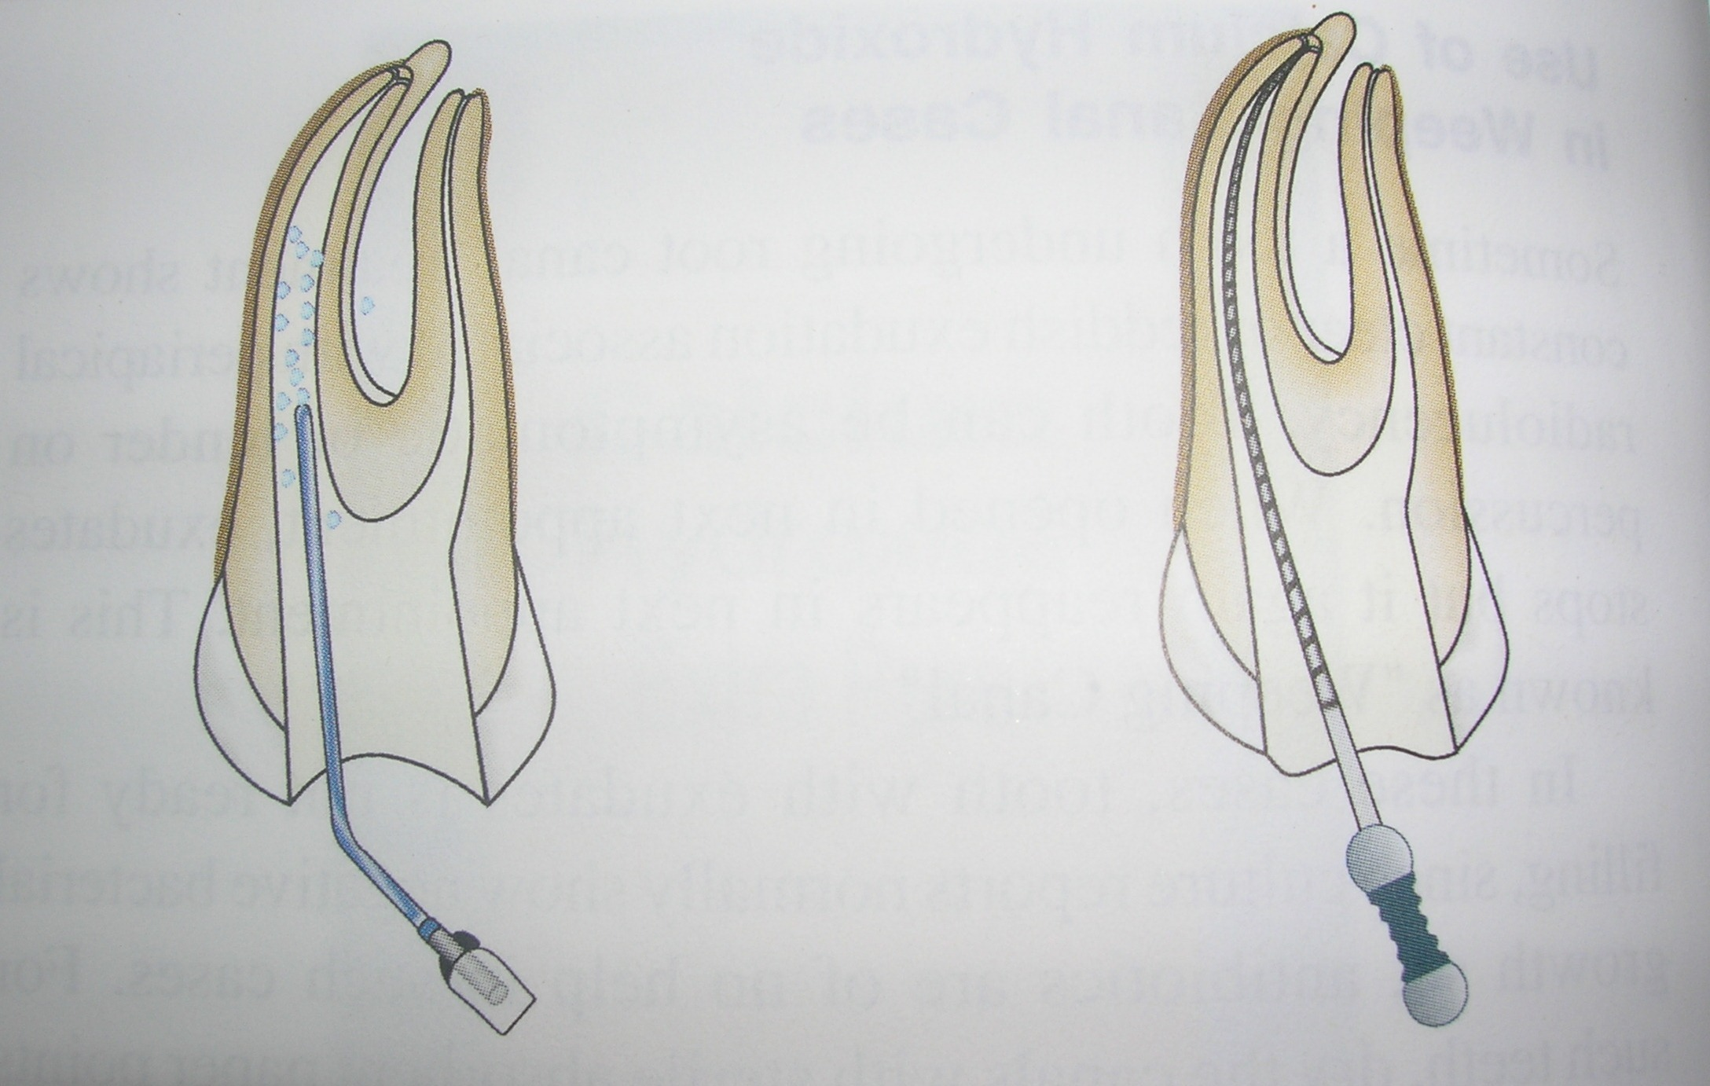
Copiously irrigate the canal Place the master apical file in the canal

Slide 27
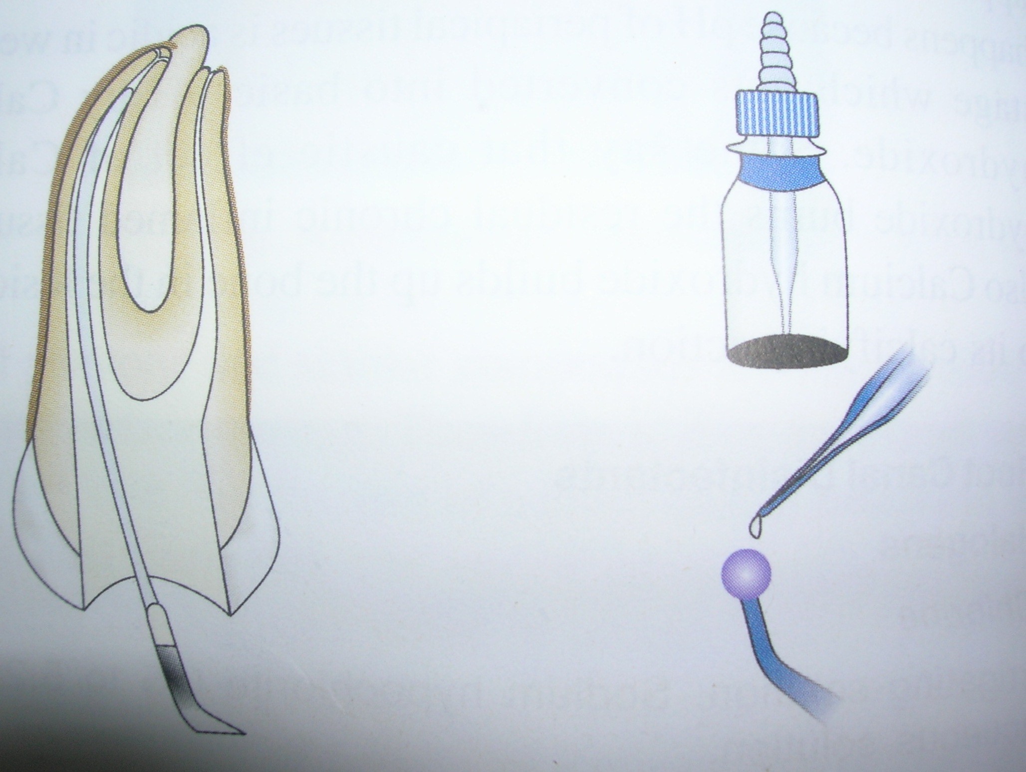
Dry the canal using absorbent paper points Intracanal medicament

Slide 28
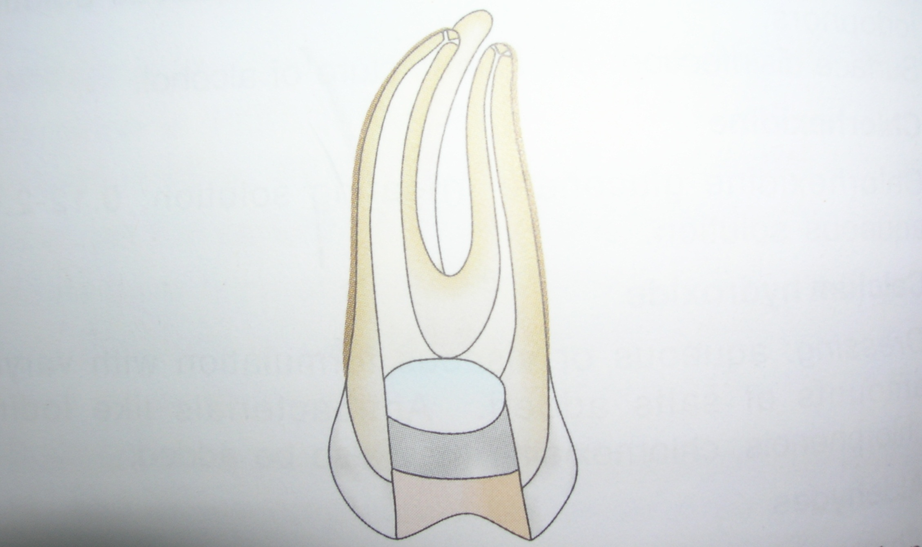
Intracanal medicament on a cotton
pellet is applied and placed in pulp
chamber. Over it, a sterile dry cotton pellet is placed which is finally sealed with a temporary filing material

Slide 29
TAKE HOME MESSAGE
The rationale for endodontic therapy is based on the belief that a natural tooth function more efficiently and comfortably than a bridge, partial denture or an implant tooth.

Slide 30
QUESTIONS
Describe various intracanal medicaments.
Classify various intracanal medicaments.
Describe the potential risk of intracanal medicaments.
Enumerate various steps of placement of intracanal medicaments.

Slide 31
REFERENCES
Science Of Dental Materials -----By ANUSAVICE, Skinners.
Restorative Dentals Materials 11th Edition By Craig.
Operative Dentistry 2nd Edition By Summit, Robbins, Schwarts

Slide 32
SUGGESTED READING
Science Of Dental Materials -----By ANUSAVICE, Skinners.
Restorative Dentals Materials 11th Edition By Craig.

Slide 33
THANK YOU

